Slide 1


Wi-Fi Performance Analysis
Specialist Programmer Intern Project
Presented By:
Team – 3 Shubhajit Rana (583059) Siddeswari Adepu (583058)
Geetika Shekhawat (583064)
Under the guidance of: Mr. Nahas Pareekutty Senior Technologist

Slide 2

INTRODUCTION
Wi-Fi has become an essential part of our digital life. From work to entertainment, stable and high-speed internet is expected everywhere.
However, Wi-Fi performance often degrades due to various factors like signal obstructions, device overload, or network congestion.
This project aims to analyze Wi-Fi performance metrics, automate data collection, and provide insightful visualizations.

Slide 3
Problem Statement :
Wi-Fi performance fluctuates due to:
High user density during peak hours
Physical obstructions (walls, glass, distance from Routers)
Interference from multiple networks and devices
There is a lack of proactive monitoring tools that store, analyze, and visualize Wi-Fi metrics in real time.
Manual checking is inefficient and not scalable in such a dynamic environment.
Need for a lightweight, automated solution to track:
Signal strength (RSSI), latency, packet loss, Bandwidth fluctuations
Time/location-based performance trends
Use Case :
Use Case: Airport Wi-Fi Monitoring
Airports serve thousands of passengers daily who rely on public Wi-Fi for communication, ticketing, navigation, and entertainment.
Airline staff and operations teams require uninterrupted network access for check-ins, boarding, logistics, and security.
Wi-Fi zones are spread across large areas — terminals, lounges, gates, baggage counters — with varying signal strength and usage load.
Real-time monitoring helps ensure QoS (Quality of Service) across the entire airport infrastructure.

Slide 4
Project Objectives
1
Automated Wi-Fi Monitoring
• Minimize manual intervention through scheduled scans
• Ensure continuous data collection in the background
2
Performance Metrics Collection
• Signal Strength (RSSI)
• Latency (Ping Delay)
• Bandwidth (Upload/Download speeds)
• Jitter and Packet Loss
3
Trend Visualization & Analysis
• Analyze collected data over time
• Comparative analysis over locations

Slide 5
Research & Literature Review
Tools & Libraries Explored
• iwconfig, ping, iperf3, speedtest-cli for data collection
• Python: os, subprocess, psutil, scapy for scripting
Visualization Options
• Evaluated matplotlib, seaborn, plotly
• Chose matplotlib for simplicity
Key Parameter Dependencies
• RSSI: Affected by distance, walls, antenna quality
• Latency: Impacted by congestion and routing
• Bandwidth: Depends on interference, users, channel
• Jitter & Packet Loss: Indicate network stability

Slide 6
Tools & Technologies Used
Python
Flask
Dash
Speedtest-cli
MongoDB
Numpy
Pandas
Plotly
Jinja2
JSON

Slide 7
Design Approach
Data Collection
Data Storage
Data Analysis & Visualization
Used speedtest-cli to collect the data. Collects metrics: Download/Upload Speed, Latency, RSSI, Jitter, Timestamp
Results stored in MongoDB for structured and scalable storage
Each entry includes test time, network metrics, and location tag.
Data fetched from MongoDB for processing.
Parameters visualized using Bar graphs, Heat Maps and Grouped Bars.

Slide 8
Implementation Flowchart
Data Collection Part
Data Analyse & Visualization Part
Start
User click on “Start Collection” on UI
Check if Collection is running or not
If not Running
If Running
Emergency Stop
Start a new thread start_collection()
Loop through each location: Get wifi data using Speedtest-cli Store in DB Repeat for next location
Stop

Slide 9
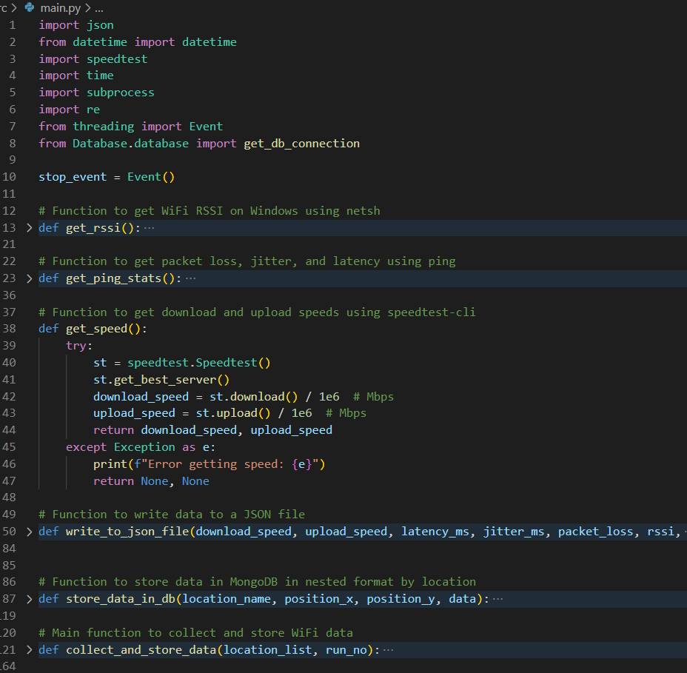
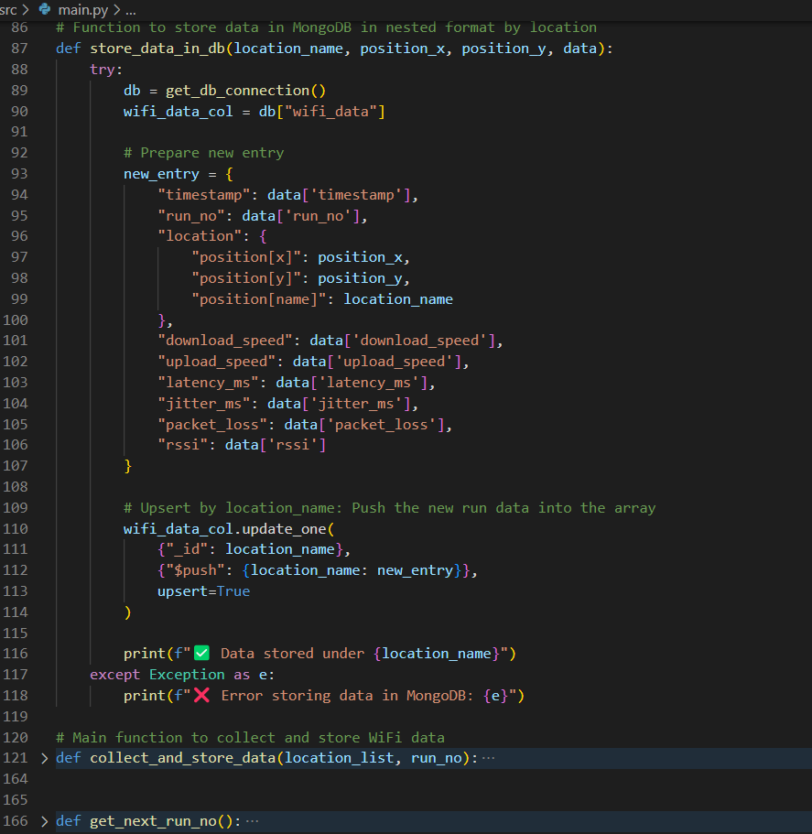
Code Snippet : Data Collection & Store

Slide 10
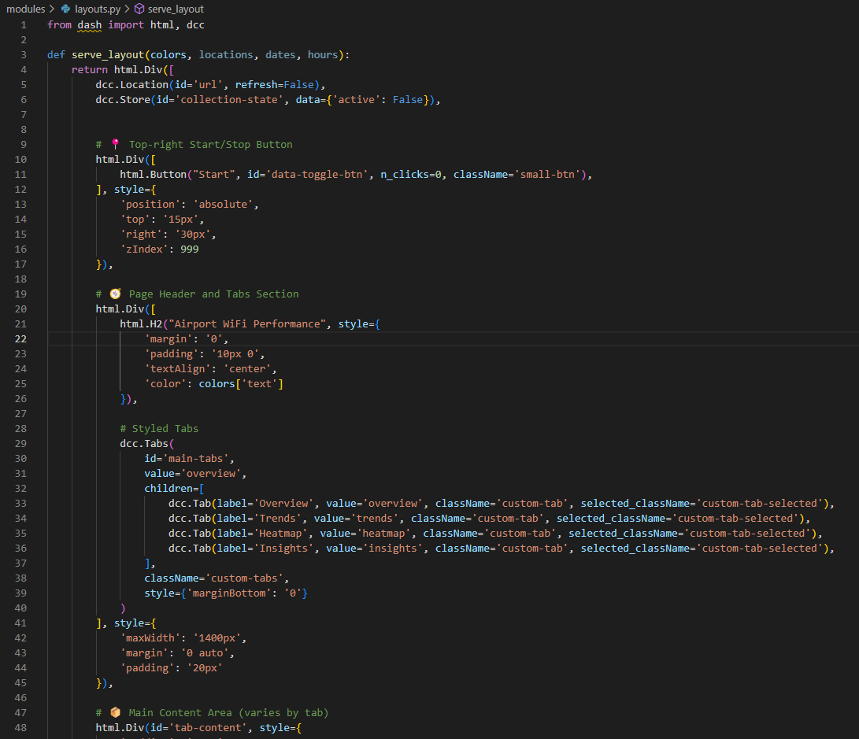
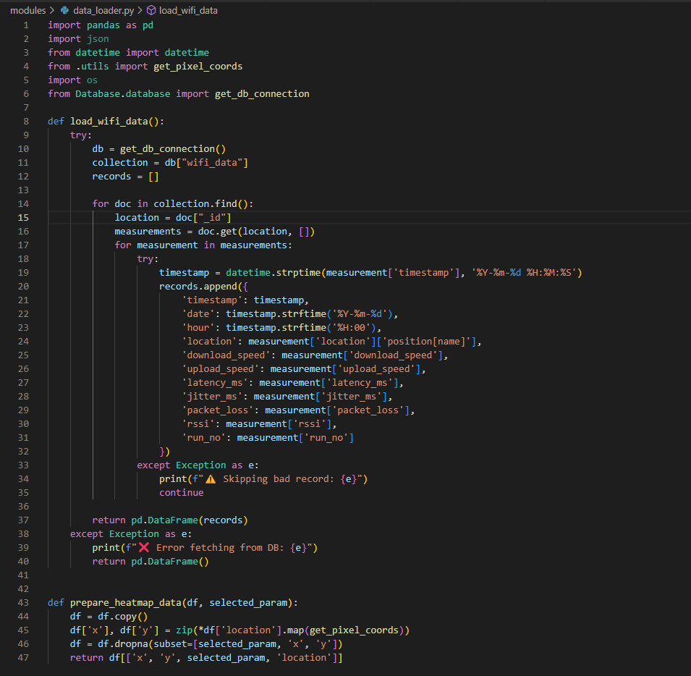
Code Snippet : Analyse & Visualize – Layouts, Data Loader

Slide 11
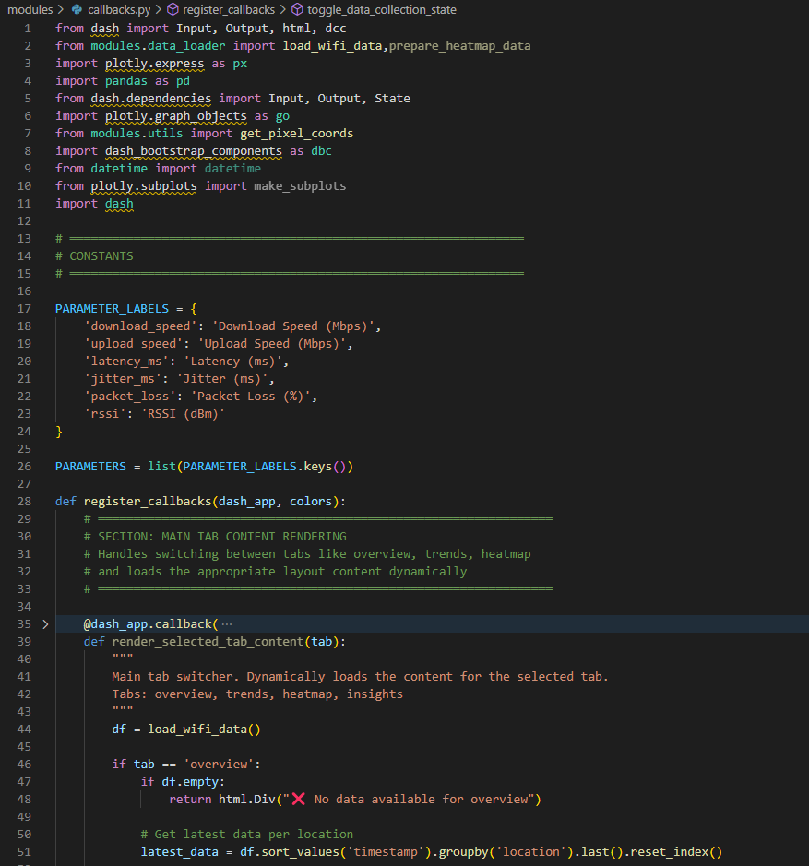
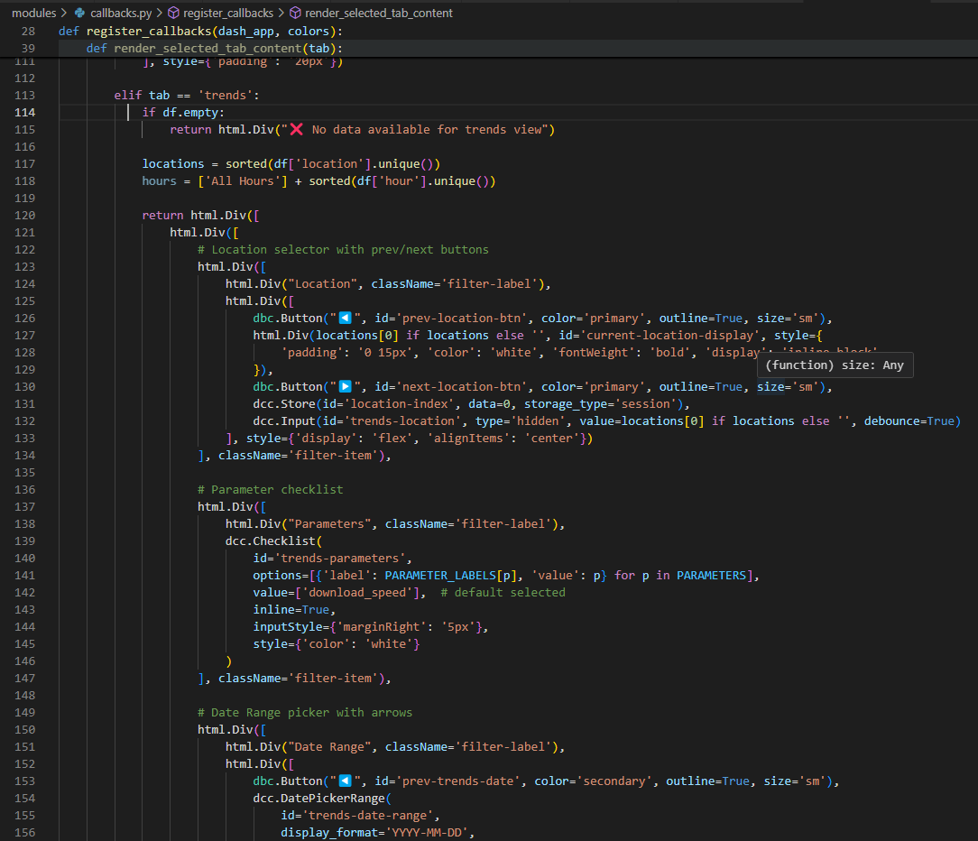
Code Snippet : Analyse & Visualize – Callbacks

Slide 12
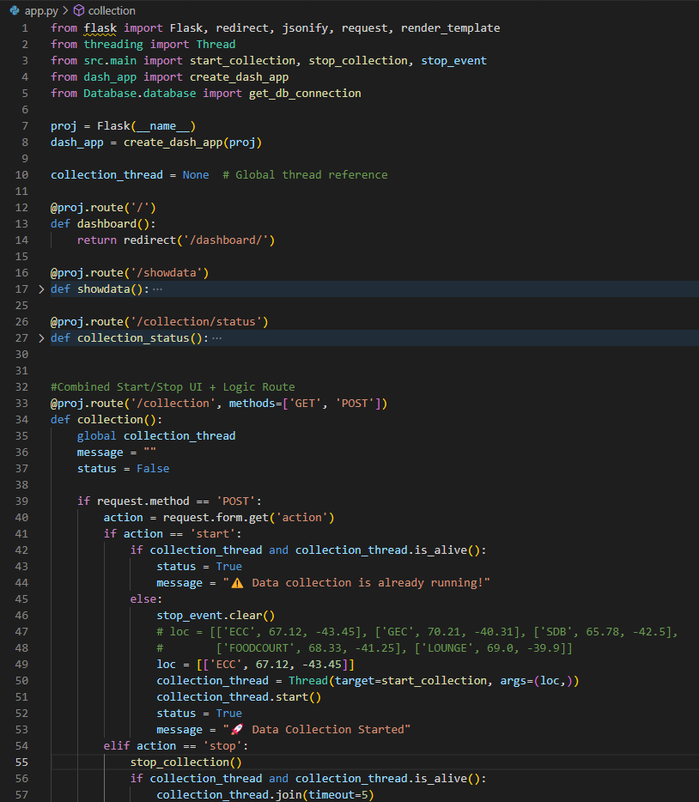
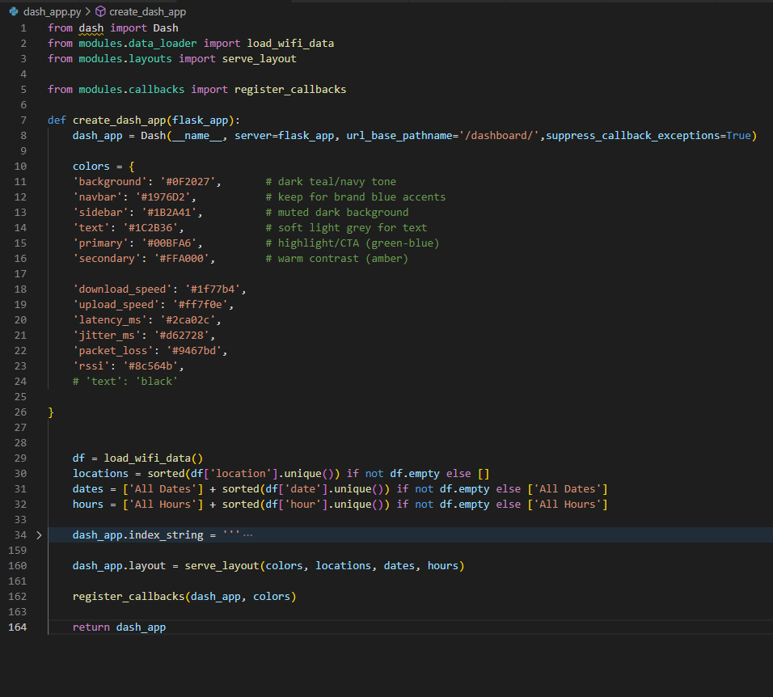
Code Snippet : App routes

Slide 13
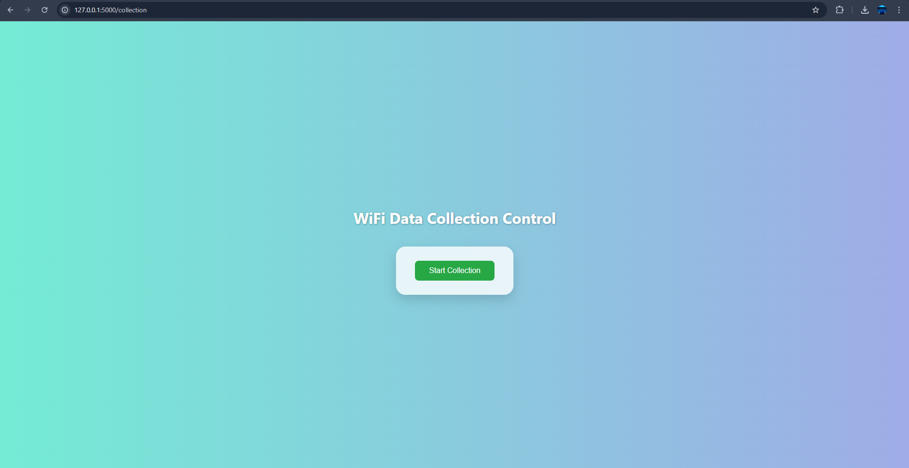
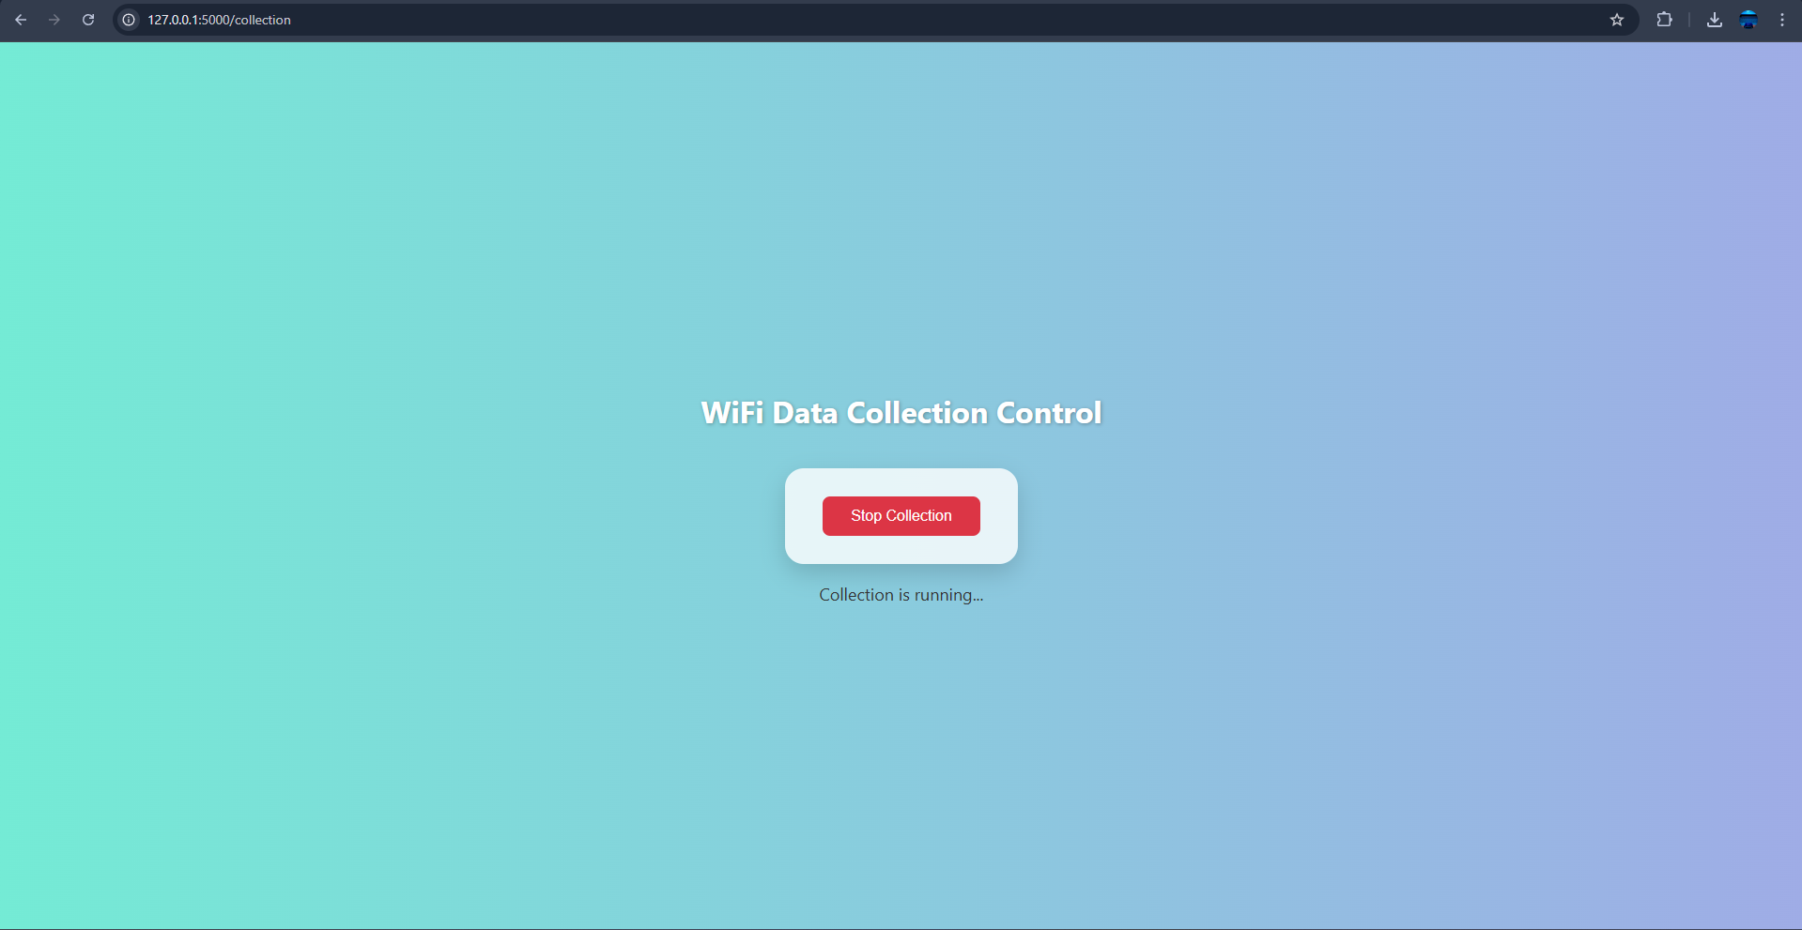
Data Collection - UI

Slide 14
Data Visualization - UI

Slide 15
Data Collection - UI

Slide 16
Challenges Faced
1. Data Extraction from speedtest-cli
• Parsing JSON output was initially inconsistent
• Required formatting adjustments for structured storage
2. Data Storage Transition
• Initially logged in JSON files
• Switched to MongoDB for better querying and scalability
3. Zero or Missing Values
• Some test runs returned incomplete results
• E.g., upload = 0, packetLoss = null, affecting accuracy
4. Visualization Challenges
• Difficulty in plotting parameters with different units
• Sparse or missing data points led to unclear trends
5. Data Collection Start/Stop Issue
• Manual control caused overlap or delays in scans
• Difficult to trigger smooth, periodic testing runs

Slide 17
Solutions & Workarounds
1. Shift to MongoDB
• Replaced flat file storage with MongoDB for efficient data handling
• Enabled filtering, aggregation, and easy updates for visualizations
2. Handling Missing or Zero Values
• Added checks to distinguish between true zero and missing metrics
• Skipped incomplete entries during trend analysis
3. Improved Visualization Strategy
• Used separate axes or normalized scales for mixed-unit charts
• Applied filters for data range and location to enhance clarity
4. Test Run Simulations
• Performed controlled test rounds to verify data flow and chart behavior
5. Threaded Execution for Data Collection
• Implemented threading to automate and control scan start/stop
• Avoided UI blocking or execution overlap during periodic runs

Slide 18
Conclusions
✅ Automated monitoring pipeline successfully built
✅ Real-time collection using speedtest-cli and MongoDB storage
✅ Visual trends and heatmaps give clear insights into performance
✅ Modular, scalable, and lightweight design makes it field-deployable

Slide 19
Possible Improvements
📶 1. Add More Parameters
• Include Browsing performance, video streaming performance for deeper analysis
📊 2. Real-Time Dashboard
• Live monitoring of ongoing tests
• Auto-refresh charts with latest performance metrics
🚨 3. Smart Alerts & Notifications
• Trigger alerts for threshold breaches (e.g., high latency, no signal)
• Notify admins for quick diagnostics and response
📲 4. Cross-Platform Compatibility
• Develop lightweight mobile version for field engineers
• Sync data with centralized backend
🧠 5. Automated Optimization Suggestions
• Recommend better access points or time slots based on patterns
• Use historical trends to improve user experience

Slide 20
Thank you

